Slide 1
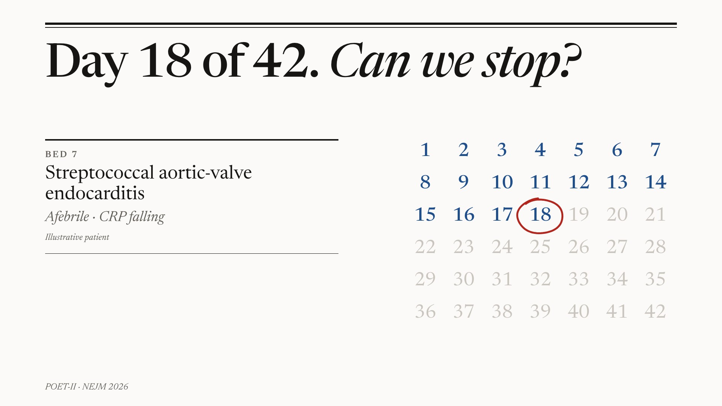
Notes:
Bed 7 — A question we face on every round, answered until now by habit.

Slide 2
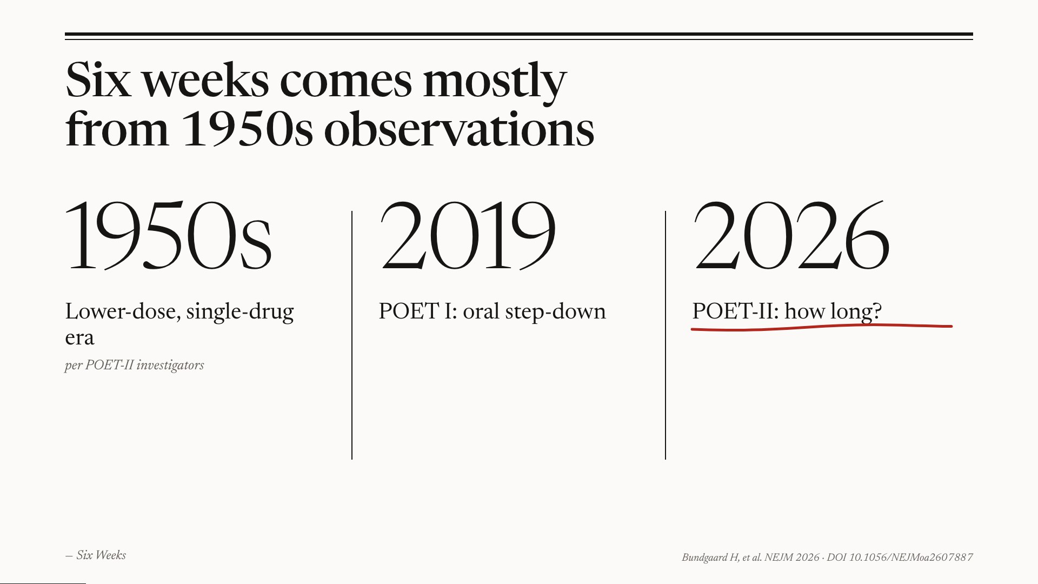
Notes:
Six Weeks — The duration rule is mostly tradition; POET I already moved us from IV to oral.

Slide 3
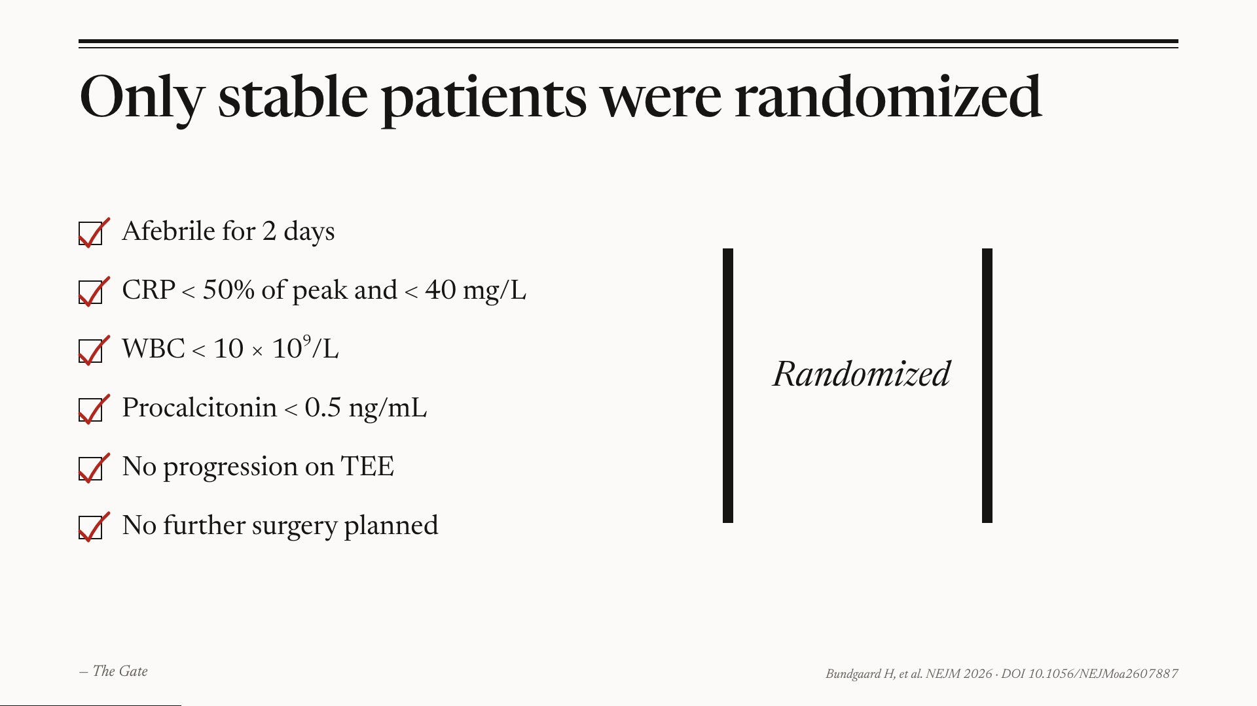
Notes:
The Gate — Only clinically stable patients were randomized — six objective criteria.

Slide 4
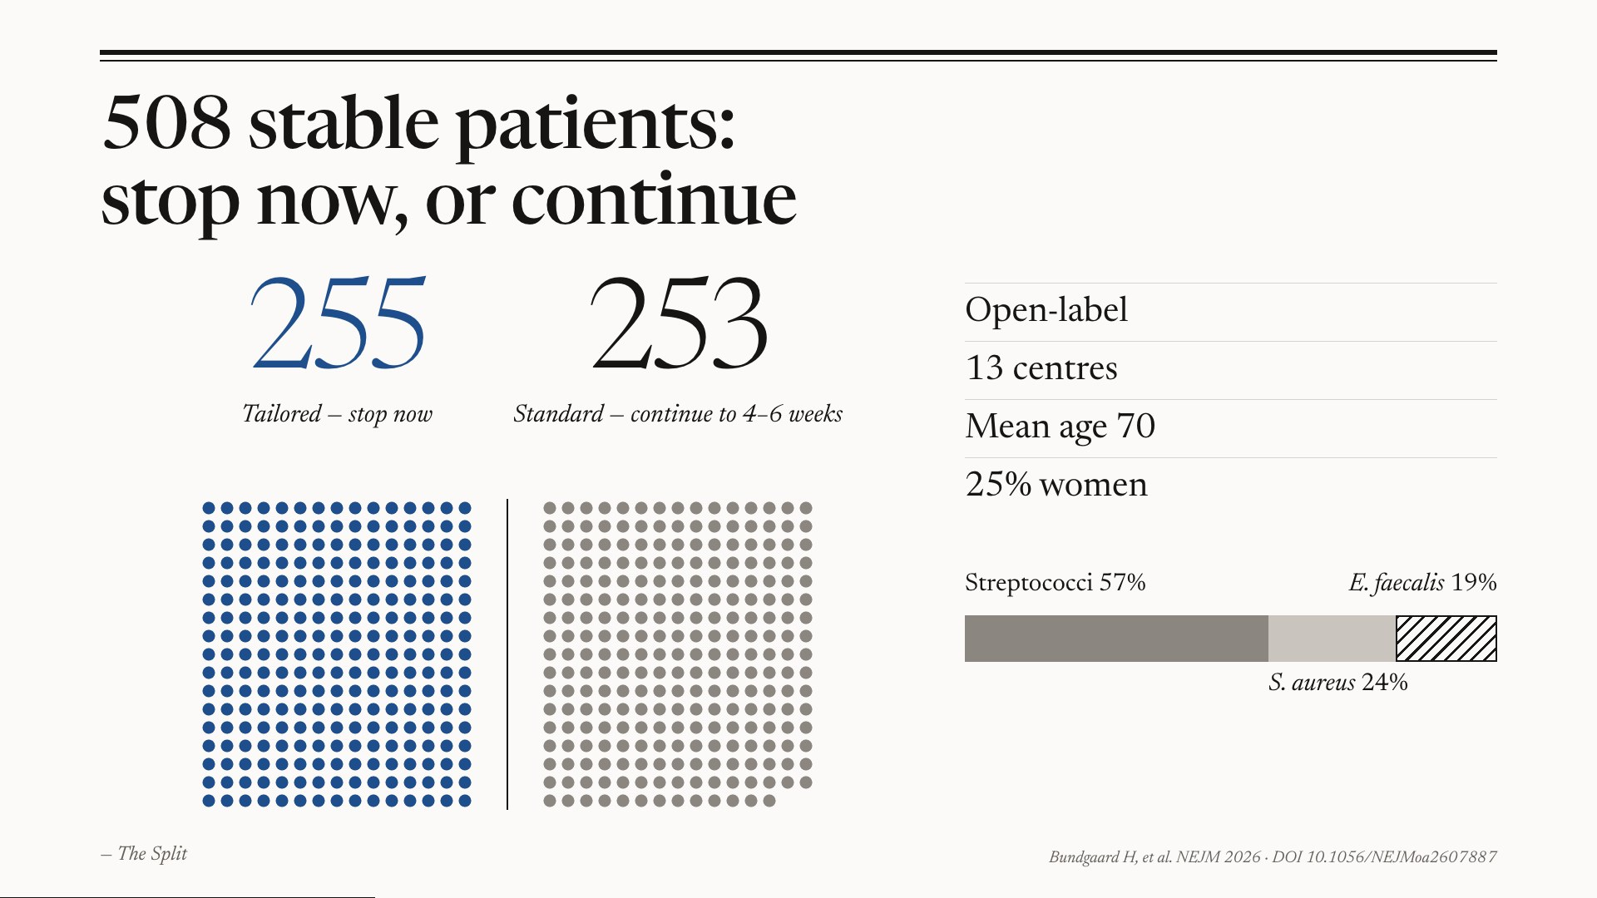
Notes:
The Split — About five hundred stable patients; half stopped on the spot, half continued.

Slide 5
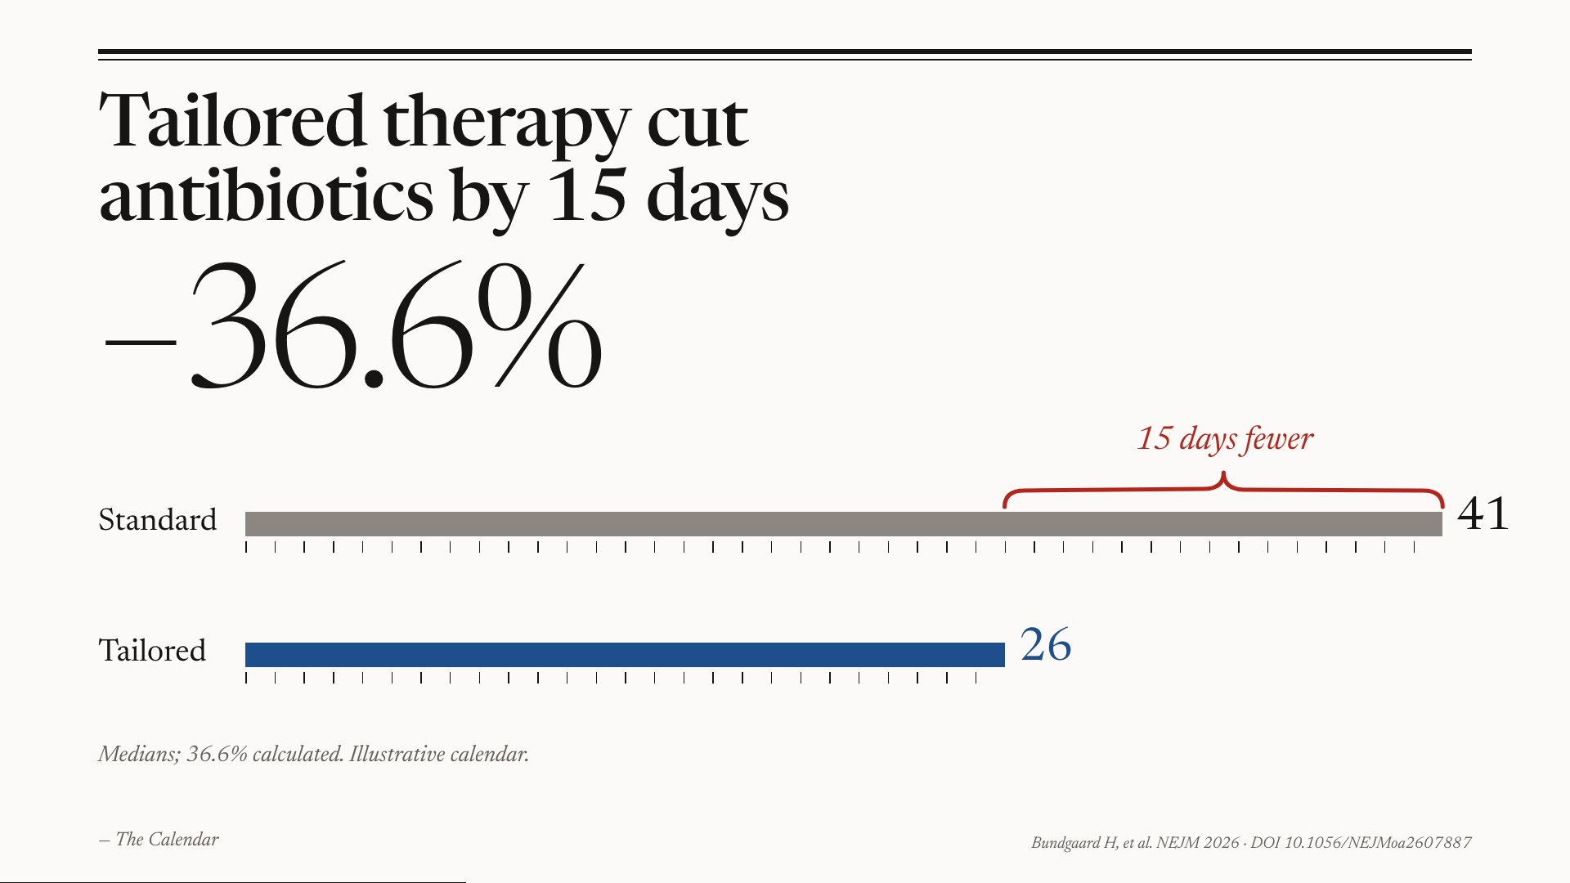
Notes:
The Calendar — Two weeks less antibiotic — about a third.

Slide 6
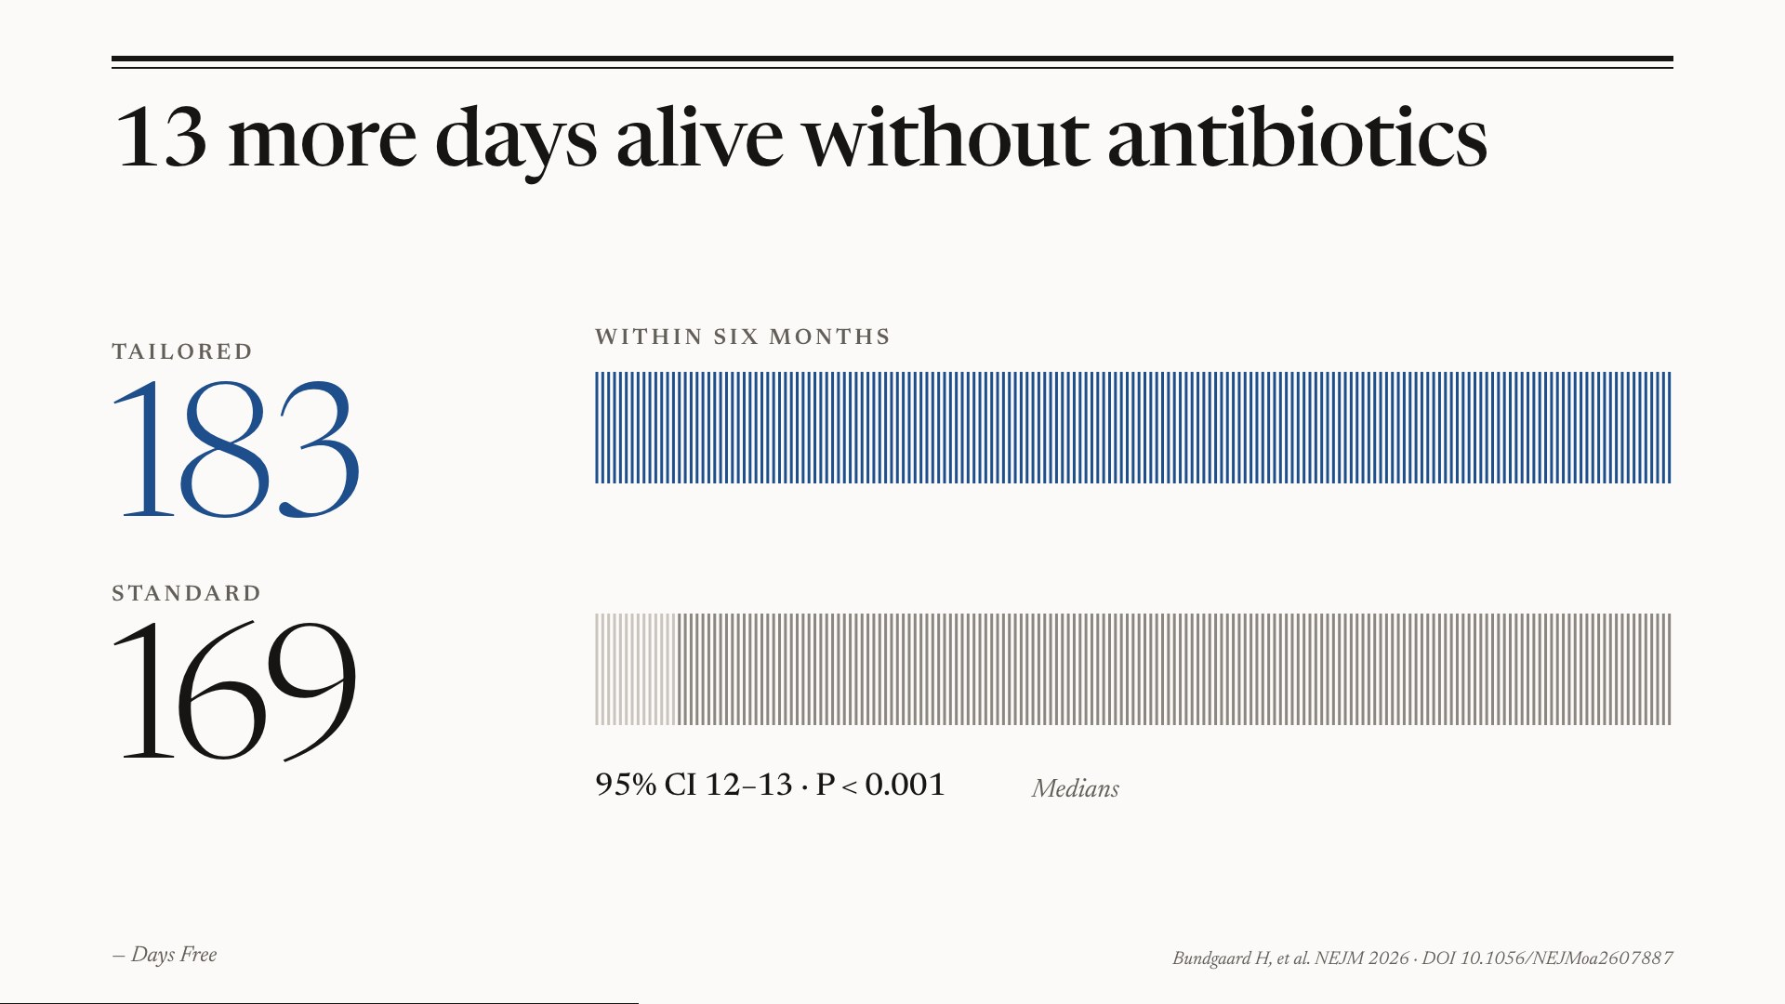
Notes:
Days Free — More days alive and free of antibiotics.

Slide 7
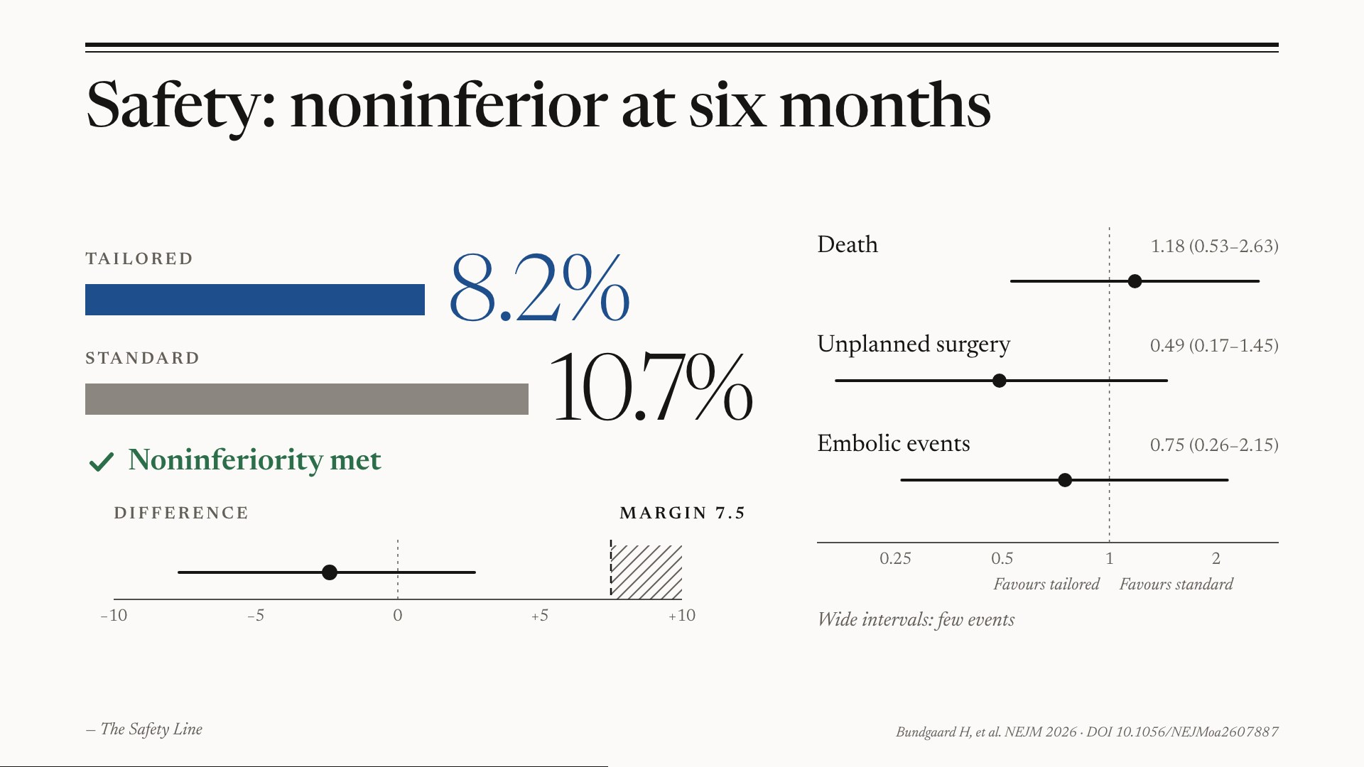
Notes:
The Safety Line — Not less safe — noninferiority met (margin 7.5 points); intervals wide because events were few.

Slide 8
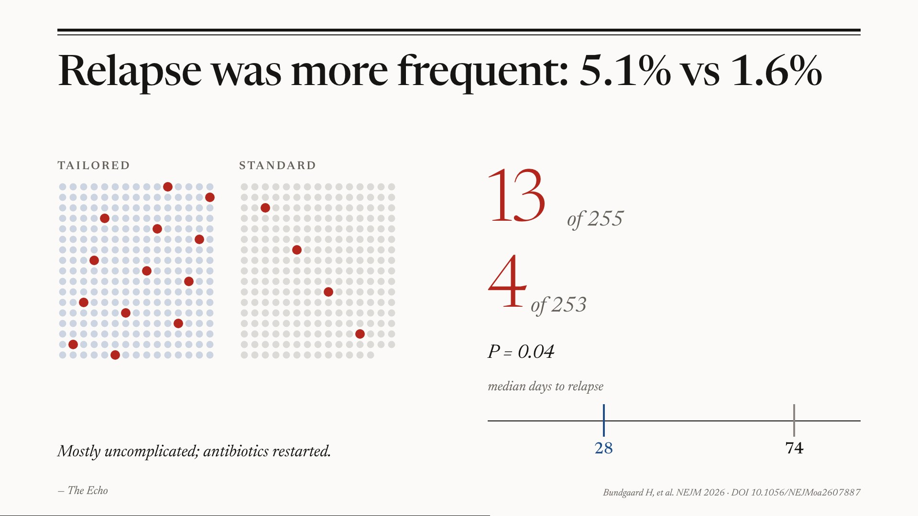
Notes:
The Echo — More relapses with tailored therapy — mostly mild, treated by restarting antibiotics.

Slide 9
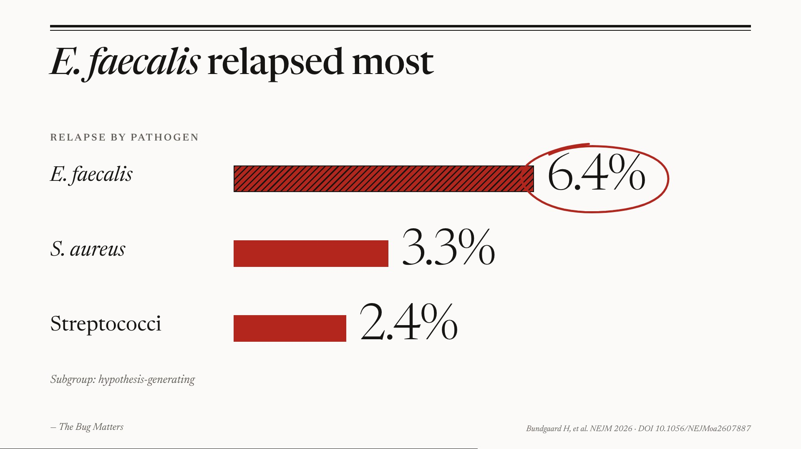
Notes:
The Bug Matters — Enterococcus faecalis relapsed most — be careful there.

Slide 10
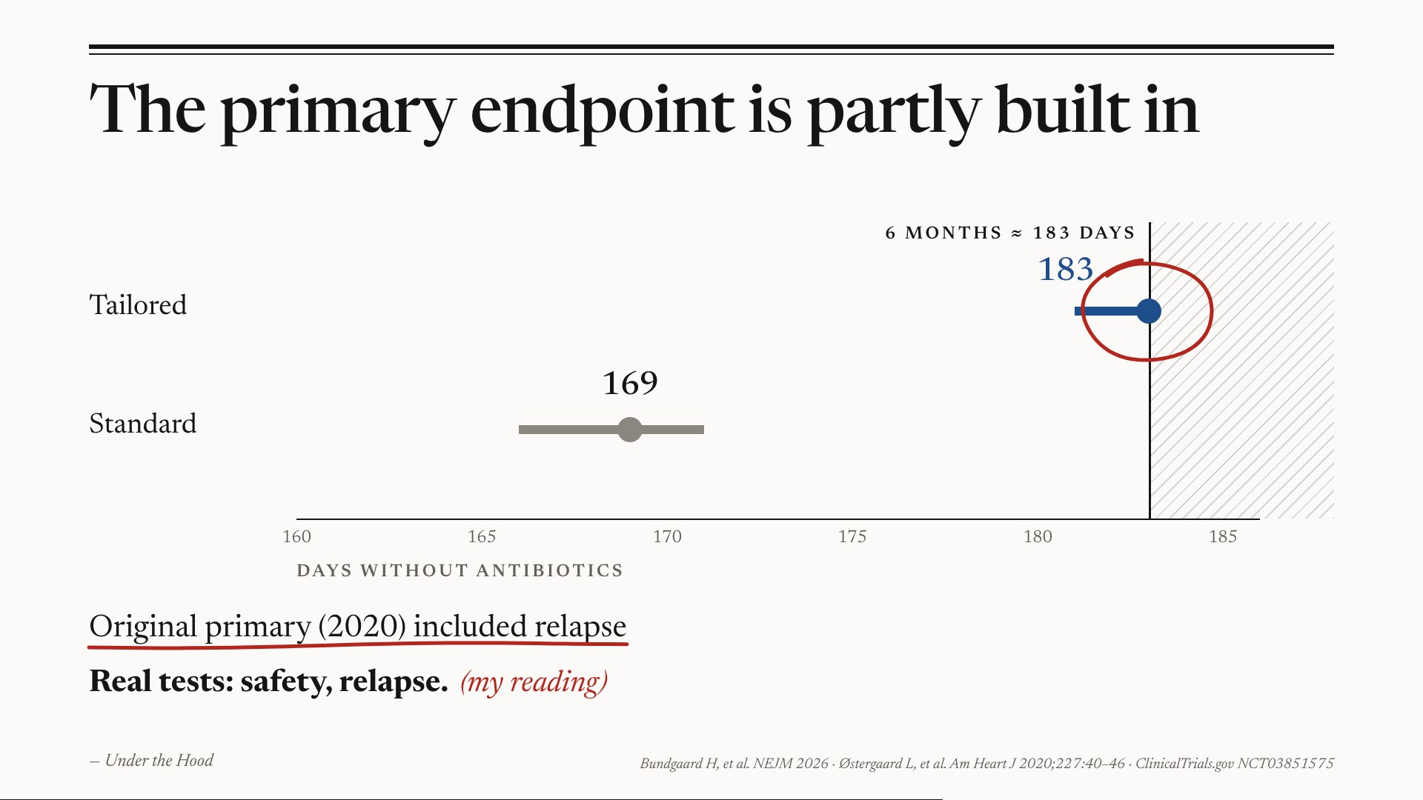
Notes:
Under the Hood — The primary endpoint is partly built in; relapse was in the original primary composite. (my reading)

Slide 11
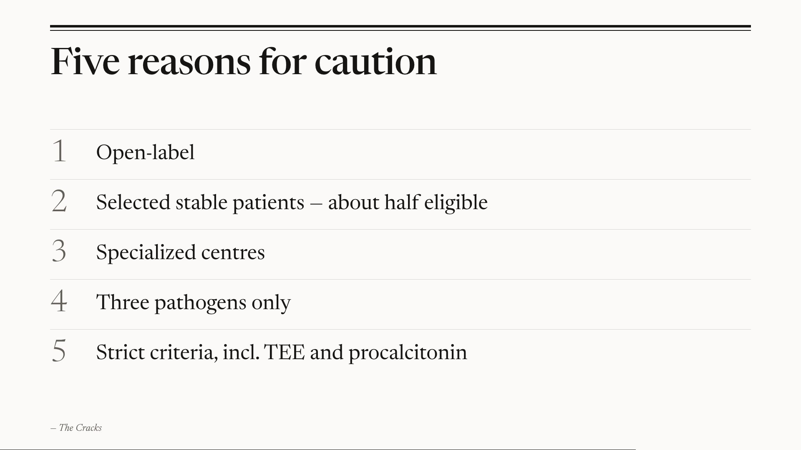
Notes:
The Cracks — Open-label, selected patients, expert centres, three bugs only, strict criteria.

Slide 12
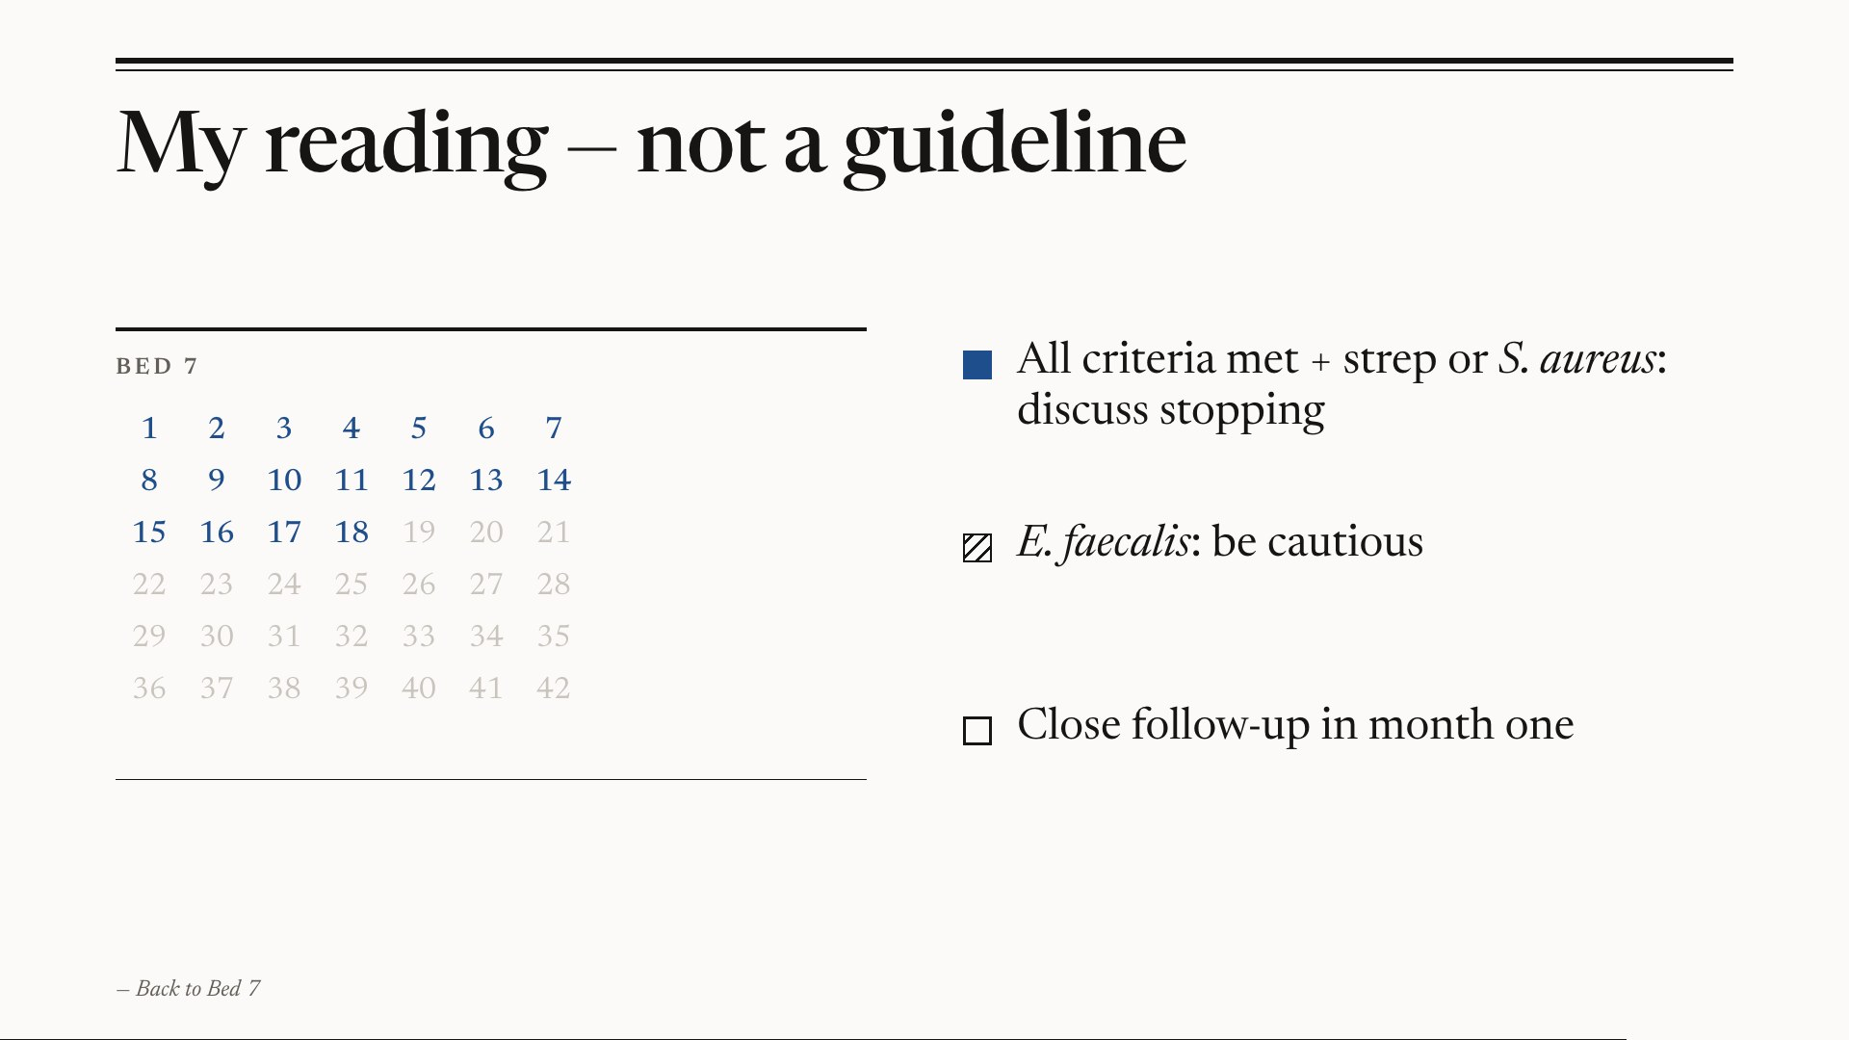
Notes:
Back to Bed 7 — My reading: decide by response, with the endocarditis team, and follow closely in month one.

Slide 13
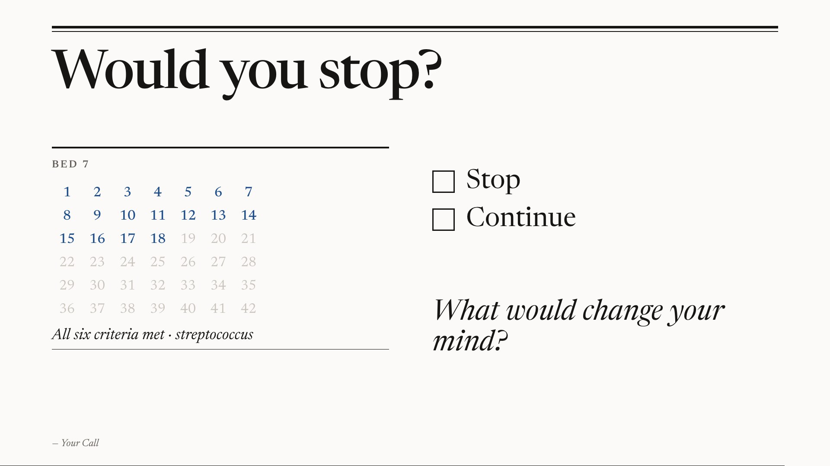
Notes:
Your Call — Invite disagreement; let the seniors talk.

Slide 14
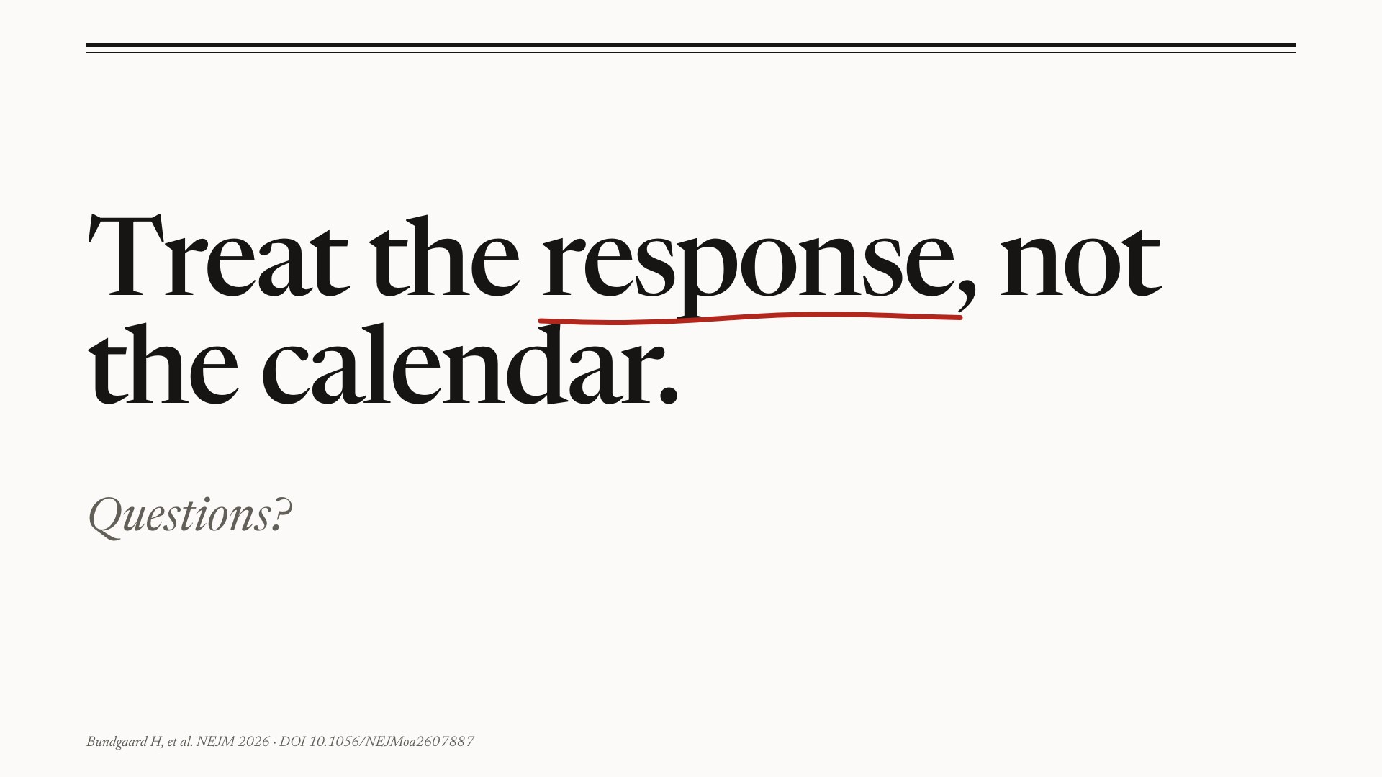
Notes:
The Last Line — Treat the response, not the calendar.

Slide 15
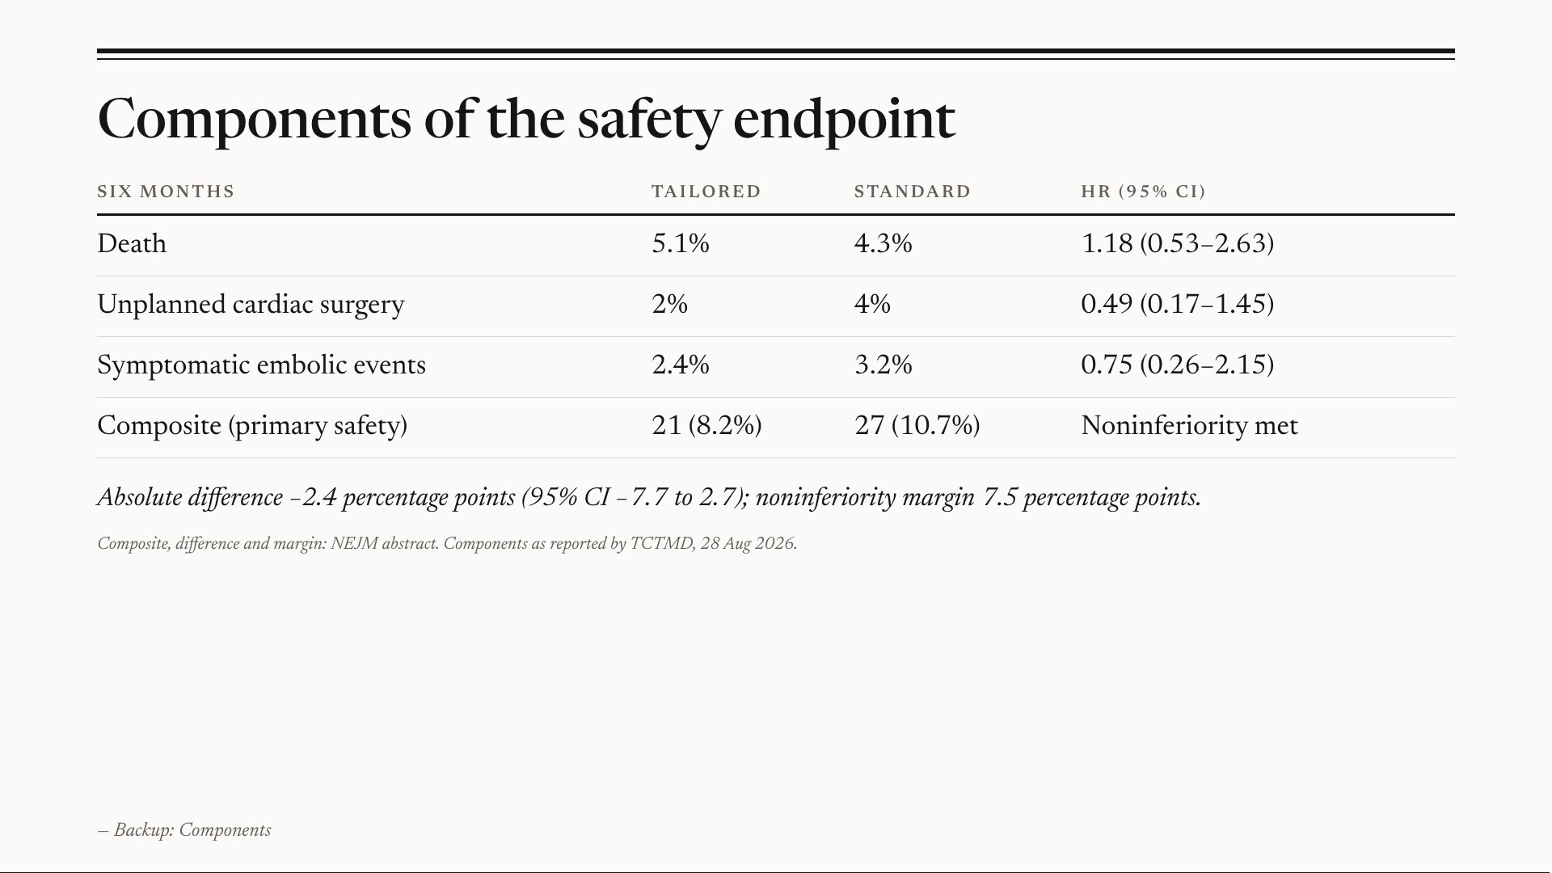
Notes:
Backup: Components — Backup slide for questions.

Slide 16
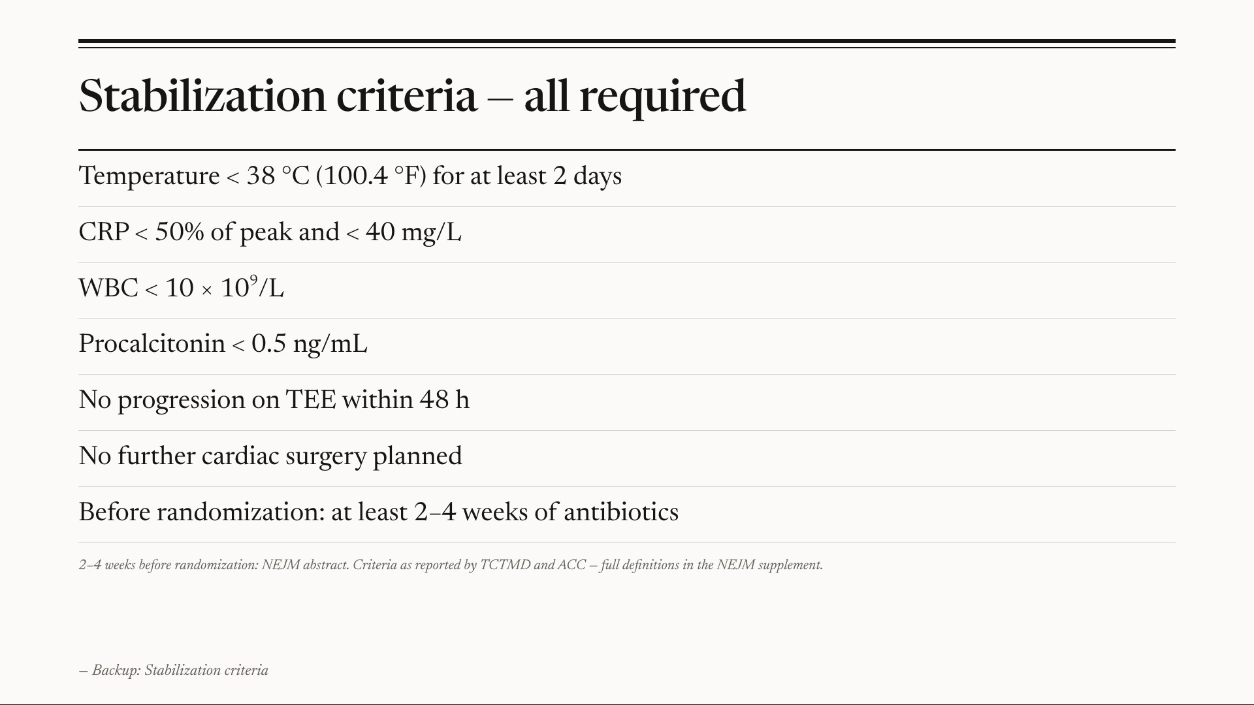
Notes:
Backup: Stabilization criteria — Backup slide for questions.

Slide 17
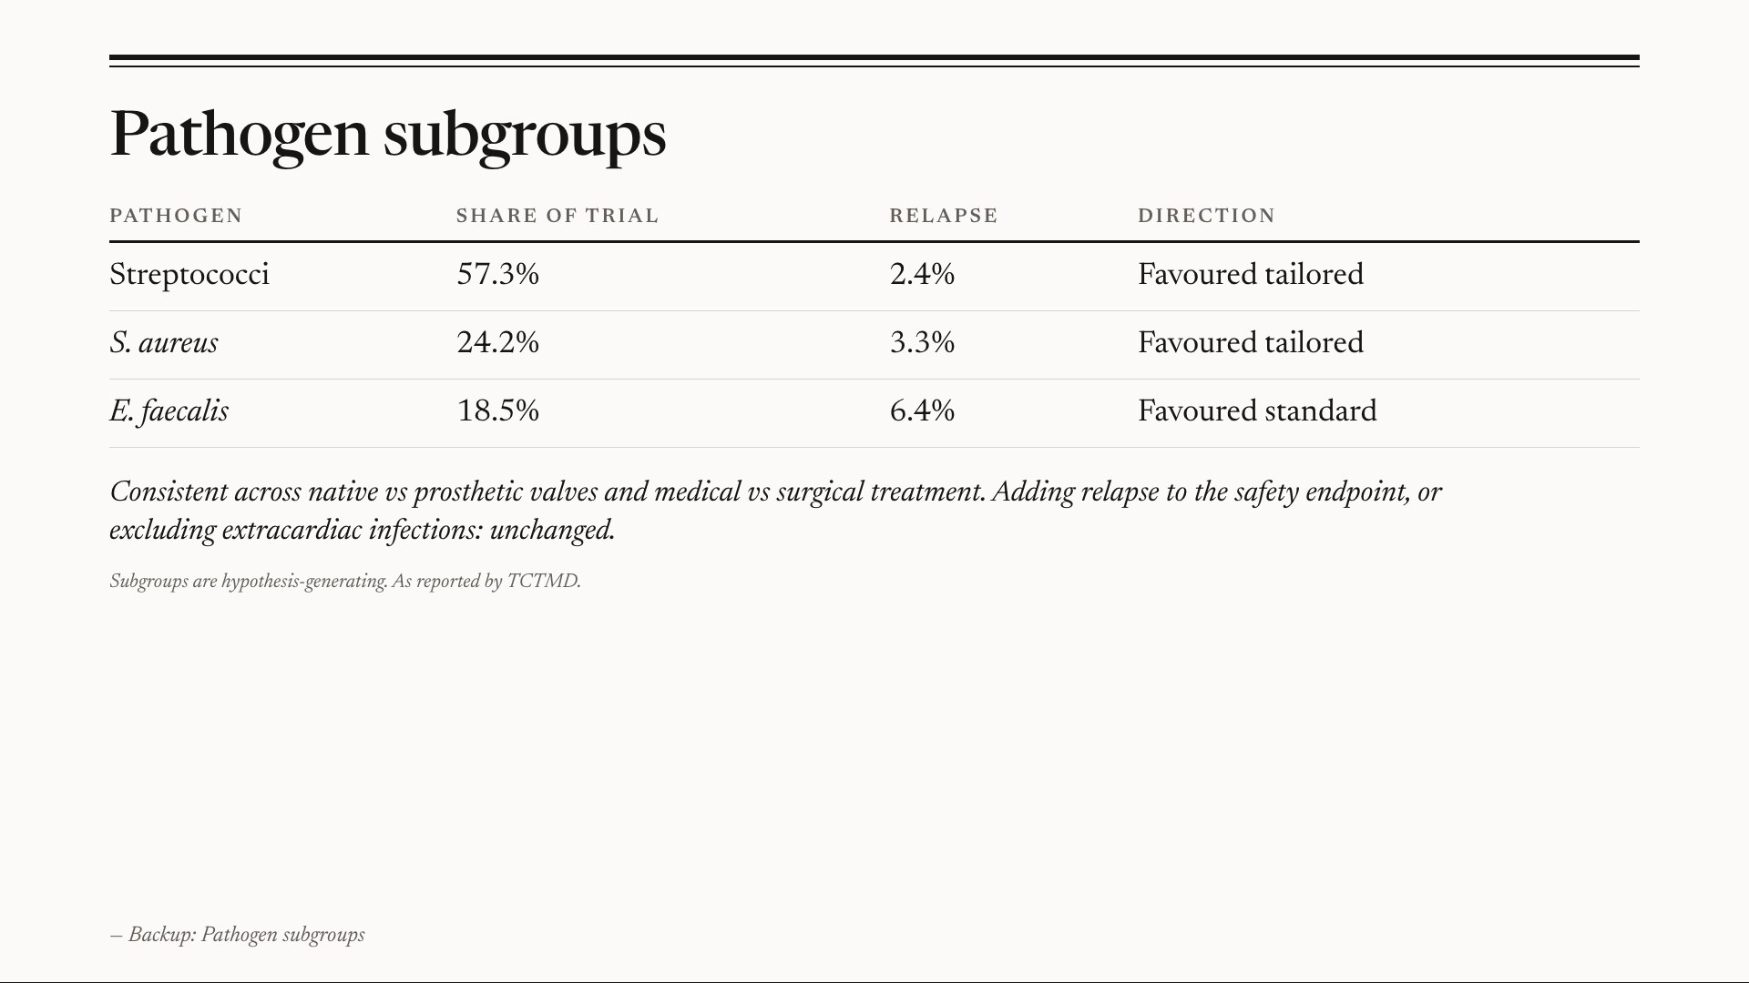
Notes:
Backup: Pathogen subgroups — Backup slide for questions.

Slide 18
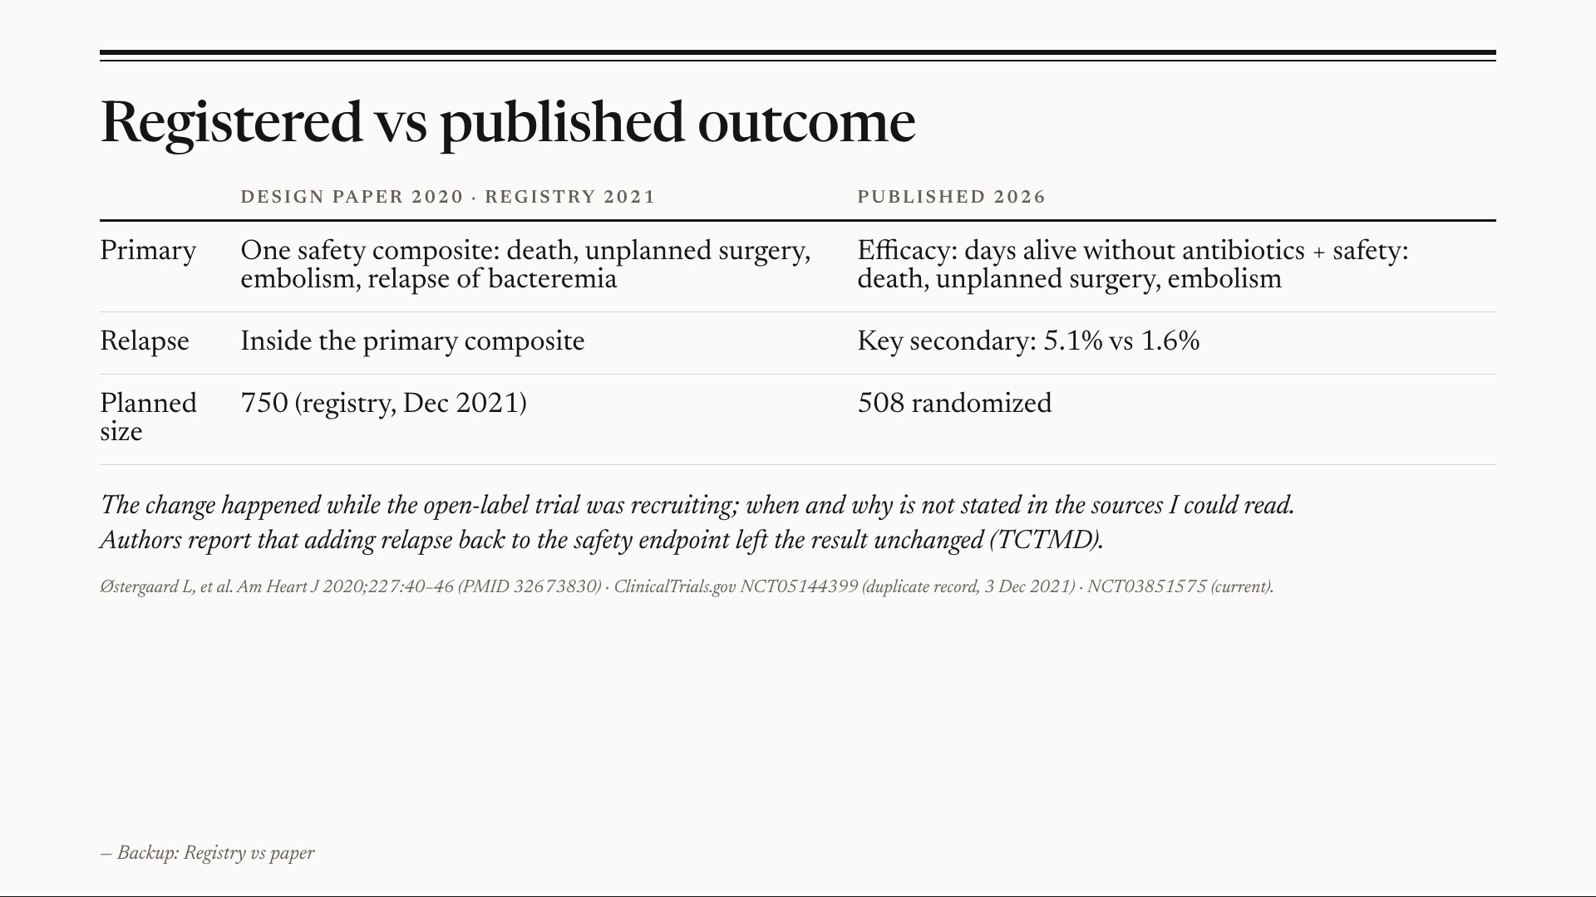
Notes:
Backup: Registry vs paper — Backup slide for questions.

Slide 19
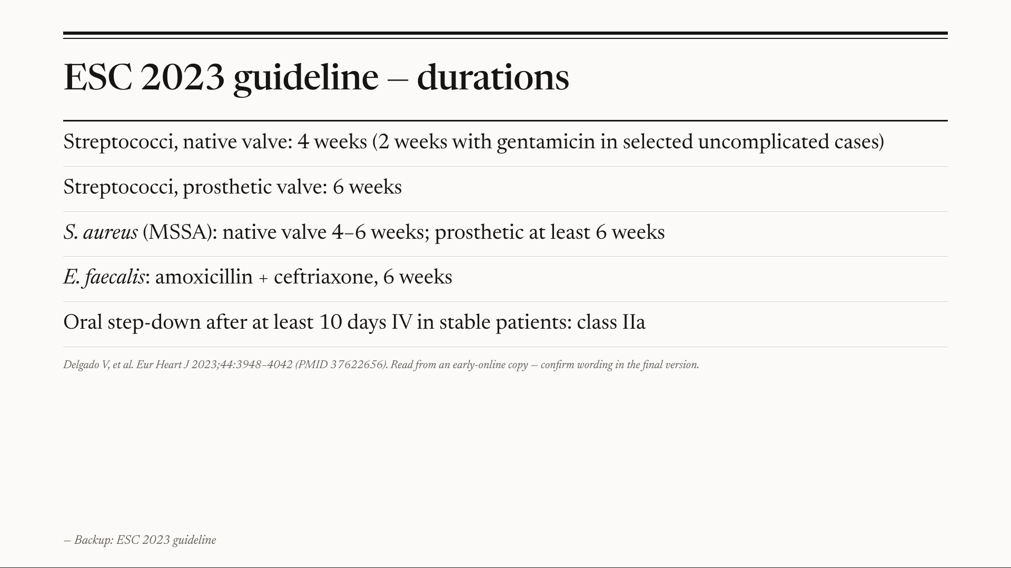
Notes:
Backup: ESC 2023 guideline — Backup slide for questions.

Slide 20
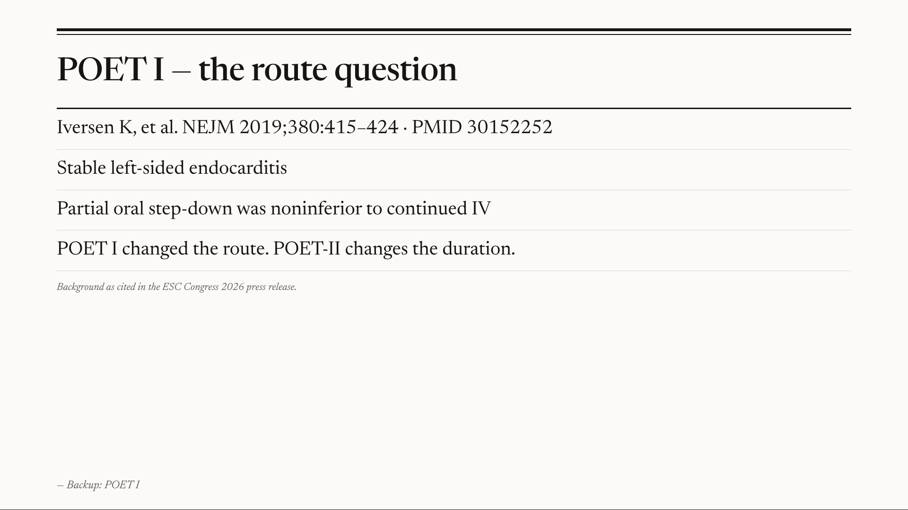
Notes:
Backup: POET I — Backup slide for questions.

Slide 21
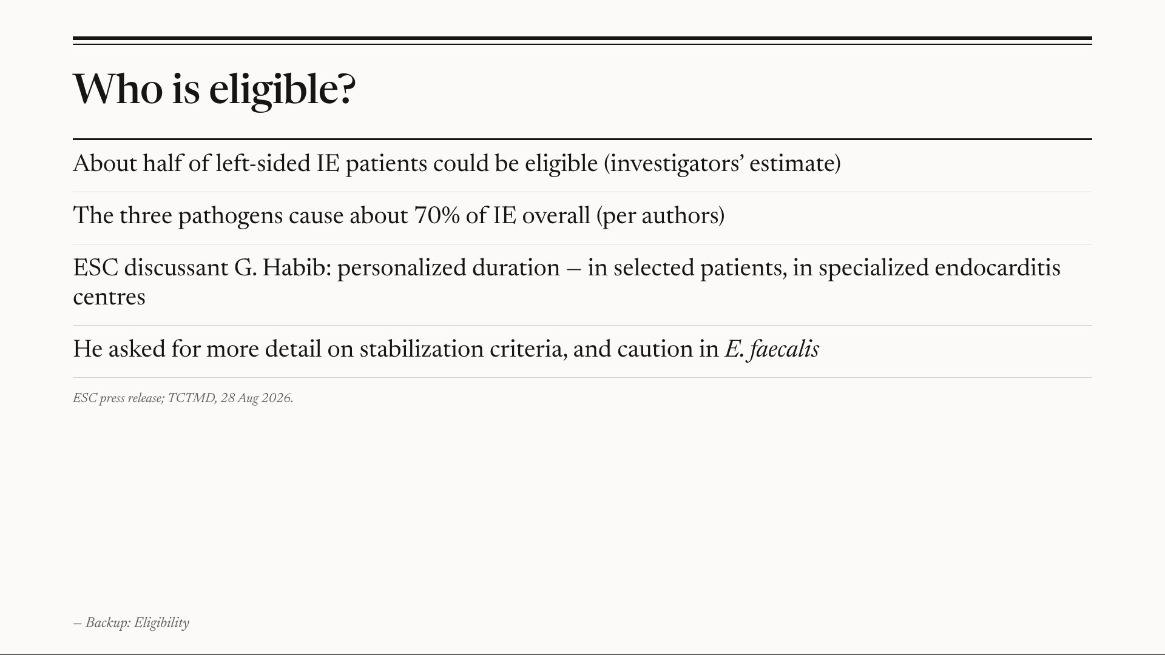
Notes:
Backup: Eligibility — Backup slide for questions.

Slide 22
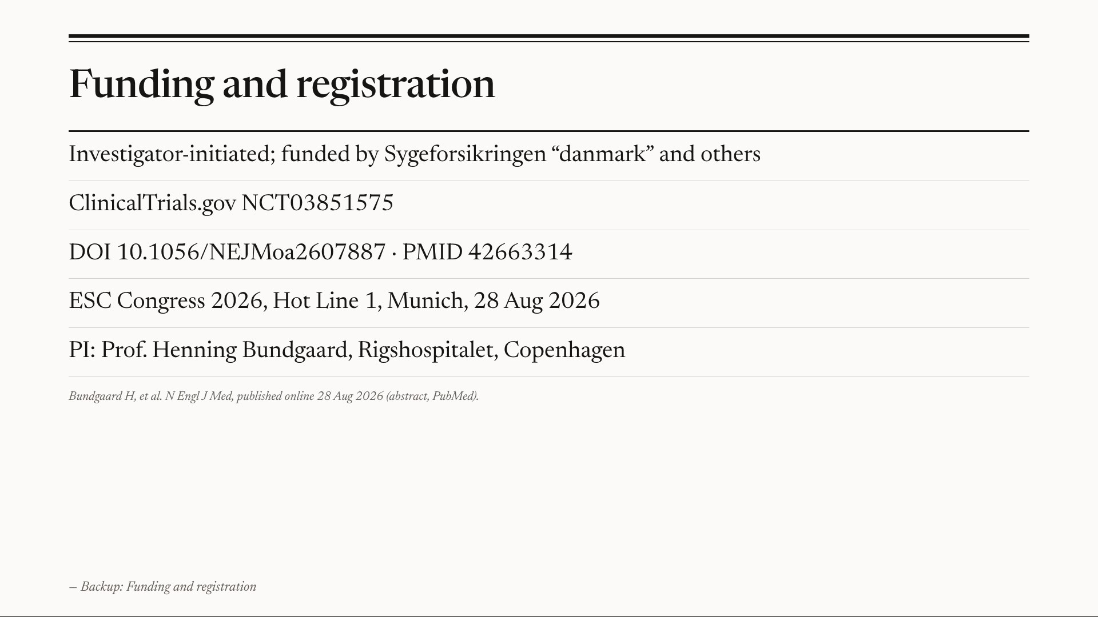
Notes:
Backup: Funding and registration — Backup slide for questions.

